Slide 1
Lecture 17
Binomial, Poisson and Normal Distributions

Slide 2
Review
1 What is the expected value of a random variable?
The long-run average of X: μ = Σ x · P(x)
2 What is the standard deviation of a random variable?
The typical distance of X from μ: σ = √Σ (x − μ)² · P(x)
3 What is a Bernoulli trial?
One trial with two outcomes: success with probability p, failure with probability 1 − p.
4 What is a binomial random variable?
The number of successes in n independent trials, each with the same probability of success p.

Slide 3
Example: free throws
Stephen Curry has made 4,236 of the 4,645 free throws he has attempted in the NBA.
p = 4,236 / 4,645 ≈ 0.912; he shoots n = 10; X = free throws made
(a) What is P(he makes all 10)?
(b) What is P(he makes at least 2), P(X ≥ 2)?
(c) How many does he make, on average?
(a) 0.912¹⁰ ≈ 0.40
(b) 1 − P(X < 2) = 1 − [P(0) + P(1)] = 1 − [0.088¹⁰ + 10 × 0.912 × 0.088⁹]
≈ 1 − 0.000000003 ≈ 1: he is all but certain to make 2
(c) μ = np = 10 × 0.912 ≈ 9.1

Slide 4
Example: a lymphoma cluster?
A doctor in a rural California county finds that 71 of his 893 patients (about 8%) were diagnosed with lymphoma last year.
US rate ≈ 21 per 100,000 people a year: p = 0.00021; X = cases among 893 patients
(a) At the national rate, how many cases should he expect, μ?
(b) Write P(X ≥ 71) with the complement rule.
(c) Software gives P(X ≥ 71). Should he contact the CDC?
(a) μ = 893 × 0.00021 ≈ 0.19 cases
(b) P(X ≥ 71) = 1 − P(X ≤ 70) = 1 − [P(0) + P(1) + … + P(70)]
(c) ≈ 1 × 10⁻¹⁵⁵: essentially impossible at the national rate, so yes

Slide 5
Is it binomial?
For each X, check the three conditions: fixed n, the same p, independent trials.
(a) X = the number of heads in 20 flips of a coin
(b) X = the number of aces in a 5-card hand
(c) X = the number of rolls of a die until the first six
(a) Yes: n = 20, p = 0.5, and the flips are independent
(b) No: the cards are dealt without replacement, so the draws are not independent
(c) No: the number of trials n is not fixed

Slide 6
The Poisson distribution
X ~ Poisson(λ)
X = the number of events in a fixed interval of time or space, when events occur independently at an average rate λ
P(X = k)
λ^{k} e^{−λ} / k!, k = 0, 1, 2, … (e ≈ 2.718)
mean and variance
μ = λ and σ² = λ

Slide 7
Example: World Cup goals
The 2022 FIFA World Cup had 172 goals in 64 matches.
λ = 172 / 64 ≈ 2.69 goals per match; X = goals in one match
(a) What is P(X = 0)?
(b) How many of the 64 matches does the model expect to end 0–0? (There were 7.)
(c) What is λ for one 45-minute half, and P(no goals in a half)?
(a) e^{−2.69} ≈ 0.068
(b) 64 × 0.068 ≈ 4.4: close, but a model is never a perfect fit
(c) λ = 2.69 / 2 ≈ 1.34, P(X = 0) = e^{−1.34} ≈ 0.26

Slide 8
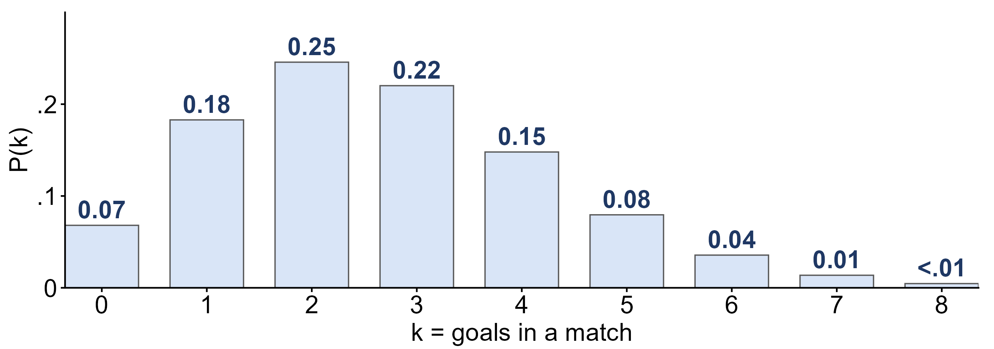
Goals per match: the Poisson model
X ~ Poisson(λ = 2.69): the probability of each number of goals in a match.
Which number of goals is most likely? Is the distribution symmetric?
Two goals (0.25), then three (0.22); skewed right: X cannot go below 0 but has no upper limit

Slide 9
The normal as a continuous distribution
X ~ N(μ, σ)
a continuous random variable: it can take any value, and its density curve is the bell curve
probability is area
P(a < X < b) is the area under the curve between a and b; the height is not a probability
P(X = c) = 0
a single value has no width, so P(X < c) = P(X ≤ c)

Slide 10
Cumulative probability
P(X ≤ x)
the area to the left of x: what the z-table and pnorm give
area to the right
P(X > x) = 1 − P(X ≤ x)
area between
P(a < X < b) = P(X ≤ b) − P(X ≤ a)

Slide 11
Example: area between
X = the height of a woman in the student heights data, modeled as normal.
X ~ N(65.4, 3.38); Week 6: P(X < 70) = 0.9131
(a) What is P(X > 70)?
(b) What is P(X < 62)?
(c) What is P(62 < X < 70)?
(a) 1 − 0.9131 = 0.0869
(b) z = (62 − 65.4) / 3.38 = −1.01: table gives 0.1562
(c) 0.9131 − 0.1562 = 0.7569 ≈ 0.76

Slide 12
What you should know: distributions
expected value
μ = Σ x P(x): the long-run average of X
binomial
successes in n independent trials with the same p: μ = np, σ² = np(1 − p); Bernoulli is n = 1
Poisson
events in a fixed interval at an average rate λ: μ = σ² = λ
normal
X ~ N(μ, σ): probability is area under the bell curve; P(X = c) = 0; P(a < X < b) = P(X ≤ b) − P(X ≤ a)

